Slide 1


Slide 2


AI Branding Assistant
2nd Year Project Synopsis
Submitted by-
ROLL NO. | NAME
2301730290 | Rishabh Rajkishor Singh
2301730305 | Harshit Rawat
2301730333 | Omm Routray
Group - 9
Industry Mentor: Mr. Ratnesh
Faculty Mentor: Dr. Amar Saraswat
Notes:
New Courses replaced with New Programmes

Slide 3

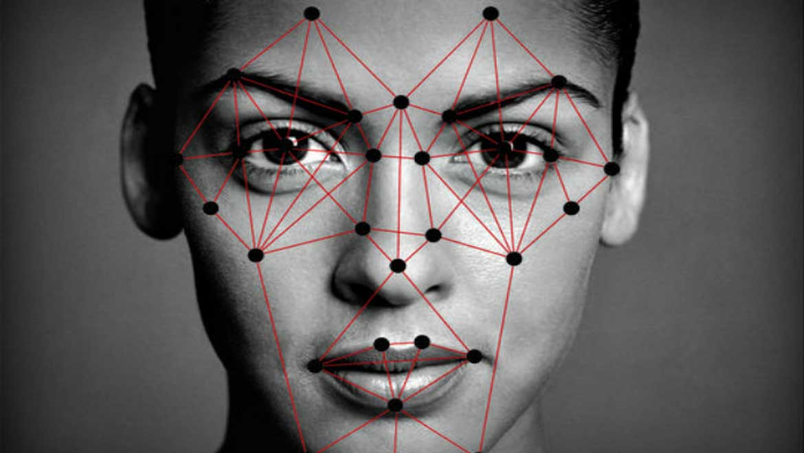


Project Overview
Project Overview
Content:
An AI-powered assistant that recommends colors, fonts, and design aesthetics
Natural language-based input for business branding
Chat-style interface for ease of use
Powered by Flask + LLaMA model
Notes:
New Courses replaced with New Programmes

Slide 4
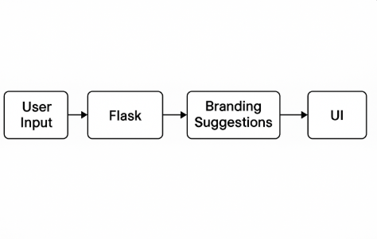
System Architecture
Tech Stack & Workflow
Content:
Frontend: HTML/CSS (Chat-style interface)
Backend: Flask Web Framework
AI Model: LLaMA via HTTP (localhost:8080/completion)
Directory:
app.py, branding_form.html, requirements.txt, etc.
Notes:
New Courses replaced with New Programmes

Slide 5
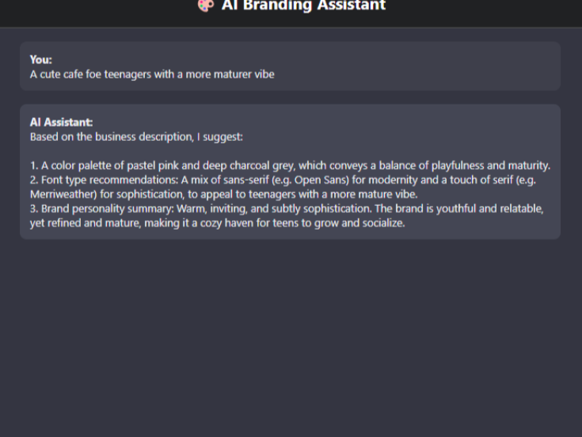
Key Features
🧠 Smart Natural Language Understanding Understands user input intelligently to provide relevant and context-aware responses.
🎨 Auto-Generated Color Palettes & Design Suggestions Instantly creates visually appealing color combinations and design ideas to spark creativity.
💬 Chat-Style User Interface Intuitive, conversational interface that enhances user experience and engagement.
📦 Easy Flask-Based Deployment Seamless deployment using Flask, making it lightweight, flexible, and developer-friendly.
Notes:
New Courses replaced with New Programmes

Slide 6
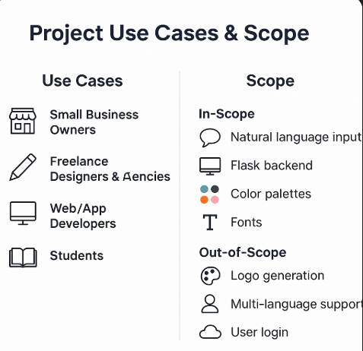
Project Use Cases & Scope
✅ Use Cases
Small Business Owners: Generate branding elements from descriptions.
Designers & Agencies: Get quick branding inspiration.
Web/App Developers: Receive UI/UX suggestions.
Students: Practice branding and design.
🌍 Scope
In-Scope: Natural language input, Flask backend, color palettes, fonts, themes.
Out-of-Scope: Logo generation, multi-language support, user login, cloud deployment.
Notes:
New Courses replaced with New Programmes

Slide 7
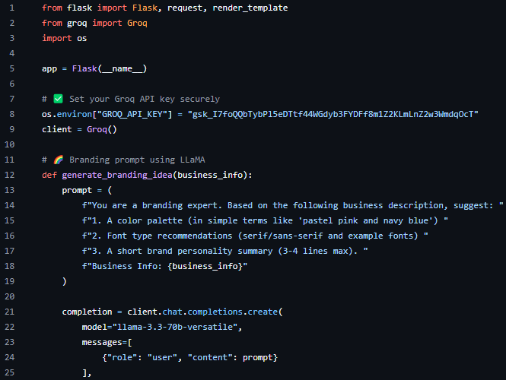
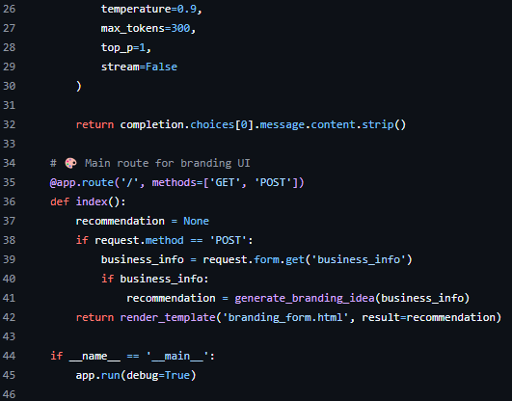
Code Snippets
Notes:
New Courses replaced with New Programmes

Slide 8
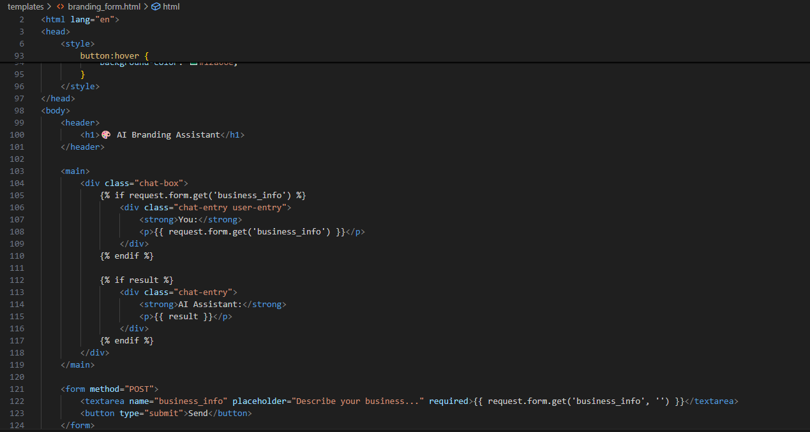
Code Snippets
Notes:
New Courses replaced with New Programmes

Slide 9
Future Implementation
Features at a Glance:-
Smart Natural Language Understanding Understands user input intelligently to provide relevant and context-aware responses.
Auto-Generated Color Palettes & Design Suggestions Instantly creates visually appealing color combinations and design ideas to spark creativity.
Chat-Style User Interface Intuitive, conversational interface that enhances user experience and engagement.
Easy Flask-Based Deployment Seamless deployment using Flask, making it lightweight, flexible, and developer-friendly.
Customizable App Logo Design Easy-to-use tools for designing a unique and professional app logo that aligns with your brand identity.
Notes:
New Courses replaced with New Programmes

Slide 10
THANK YOU

